Slide 1
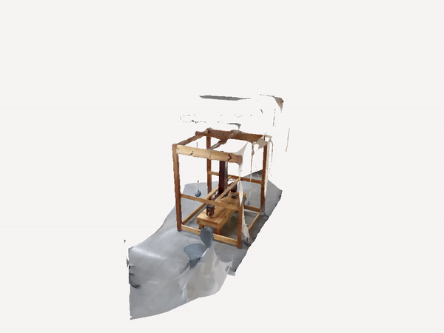
Cavendish:
10 DEC 2024
PHYS 461
Measuring G, the “weight” of gravity.
Cordney Nash and Micah Hillman

Slide 2
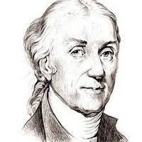
History
Henry Cavendish
Known for the discovery of Hydrogen: “inflammable air”.
Also remembered for devising an experiment to measure Newton’s universal gravitation constant, G.
Performed his 1798 experiment in order to measure the Earth’s density, not G directly.²
His methods only later found use in finding G.
Notes:
Henry Cavendish was an English-French natural philosopher, who was pretty famous for conducting physics experiments. Born in Nice - France, Cavendish’s parents are Lady Anne de Grey and Lord Charles Cavendish. Born into an aristocratic family, Cavendish was educated at Cambridge but after 3 years he left without obtaining a degree. He studied science under his father’s wing and became involved with the Royal Society which allowed him to engage in experimental research. Throughout his life, Cavendish played a big role in advancing scientific knowledge, both through his experiments and his participation in key scientific organizations, like the Royal Institution of Great Britain.
He is best known for discovering hydrogen, which he coined "inflammable air." He described its properties and demonstrated its ability to form water upon combustion.

Slide 3
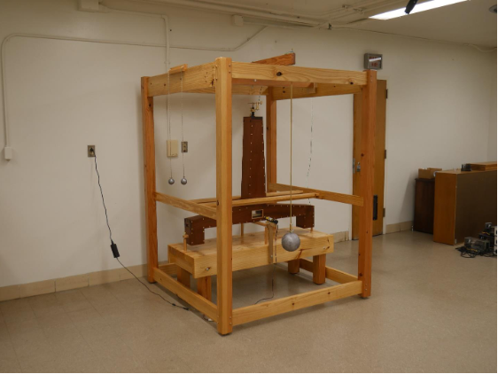
History
Inherited the apparatus from geologist John Michell.²
Tuning allowed Cavendish to measure within 1% of the current accepted value.¹

Slide 4
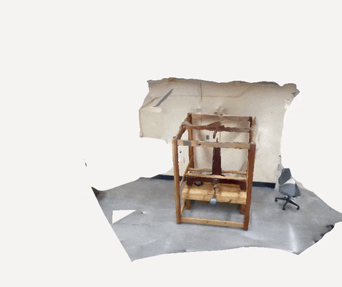
Experimental Design
Torsion balance (“horizontal pendulum”) system designed to isolate the influence of external gravity (a)
Grounding wires ensure absence of electromagnetic forces.
Hermetic box surrounding the balance system --> minimal influence from air currents.
System exhibits damped harmonic motion.
“HENRY”

Slide 5
Experimental Design
M
Torsion balance (“horizontal pendulum”) system designed to isolate the influence of external gravity (a)
Grounding wires ensure absence of electromagnetic forces.
Hermetic box surrounding the balance system --> minimal influence from air currents.
System exhibits damped harmonic motion.
“HENRY”
(a)
m
m
m
(c)
(b)
M

Slide 6
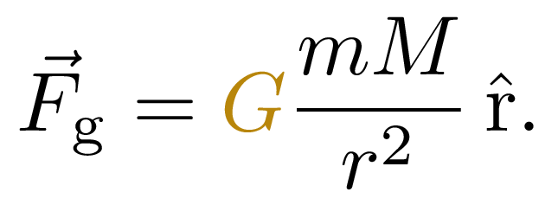
Experimental Design
M
Large lead masses (b)
Induce a gravitational torque τ on the torsion balance and shift its equilibrium.
Torsion balance oscillates around new equilibrium — damped harmonic motion.
Induced force mediated by Newton’s Law of Universal Gravitation:
(a)
m
m
m
(c)
(b)
M

Slide 7
Experimental Design
Large lead masses (b)
Induce a gravitational torque τ on the torsion balance and shift its equilibrium.
Torsion balance oscillates around new equilibrium — damped harmonic motion.
Induced force mediated by Newton’s Law of Universal Gravitation:
M
(a)
m
m
m
M
(c)
(b)

Slide 8
Experimental Design
Laser–mirror system (c)
Allows us to track the oscillation induced by the large masses.
Laser reflected to board distance D from mirror. Position recorded with camera, meter stick.
M
(a)
m
m
m
M
(c)
(b)

Slide 9
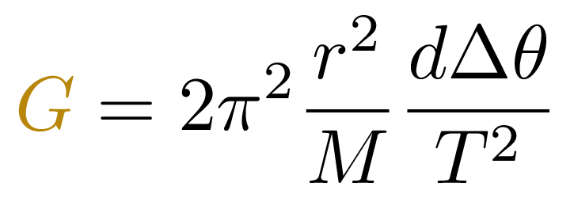
Theory
Derived from balancing Newton’s gravitation with principles of torsion pendulum.

Slide 10

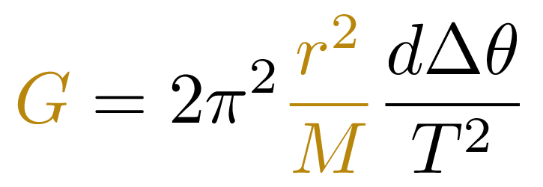
Theory
r
M

Slide 11
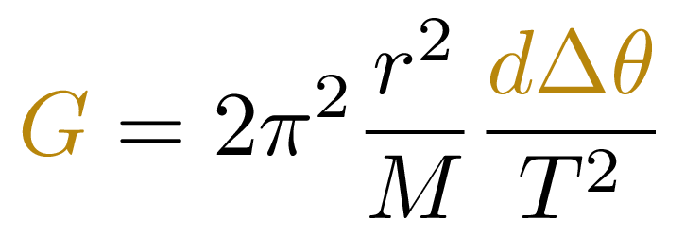
Theory
Arc length swept by each small balance mass due to changing equilibrium. (Related to laser position).
d
m
m

Slide 12
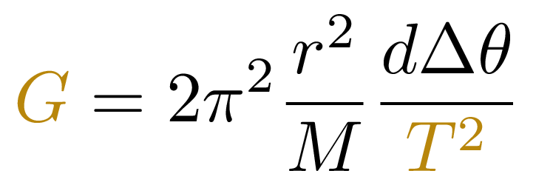
Theory
Period of oscillation.

Slide 13
Procedure
Turn on the laser.
m

Slide 14
Procedure
Turn on the laser.
m

Slide 15
Procedure
Position board, meter stick on wall opposite the torsion balance and laser.
Record the distance D between the board and torsion balance.

Slide 16
Procedure
Set up camera to take photos:
every 20 sec,
for 90 min.

Slide 17
Procedure
M
Slowly position large masses at a distance r from the torsion balance masses.
m
m
m
M

Slide 18
Procedure
Slowly position large masses at a distance r from the torsion balance masses.
Once they are in place, begin taking photos at the specified interval and duration.
M
m
m
m
M

Slide 19
Procedure
After 90 min have passed, move the lead weights to the other side.
Once again, take photos at the specified interval and duration.
M
m
m
m
M

Slide 20
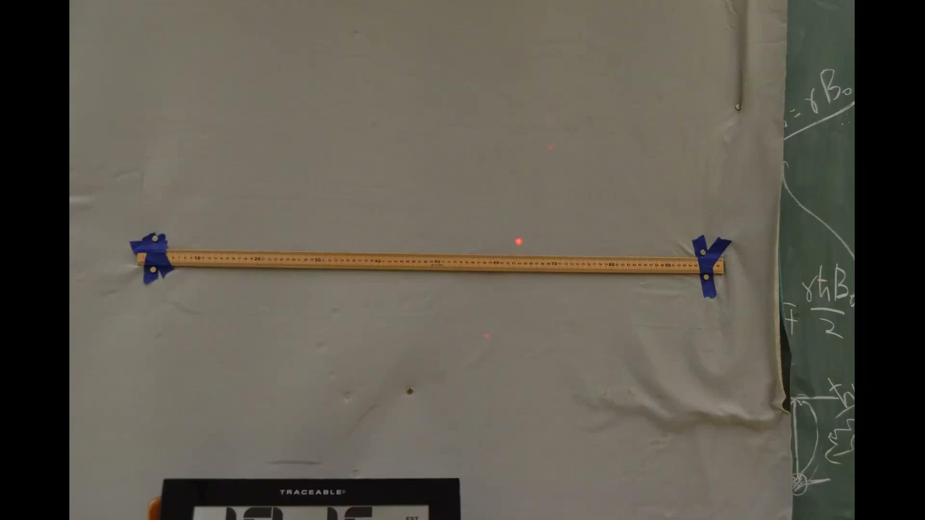
Analysis
Captured photos combined to video and processed in image tracking software.
Distance tracking calibrated to meter stick.

Slide 21
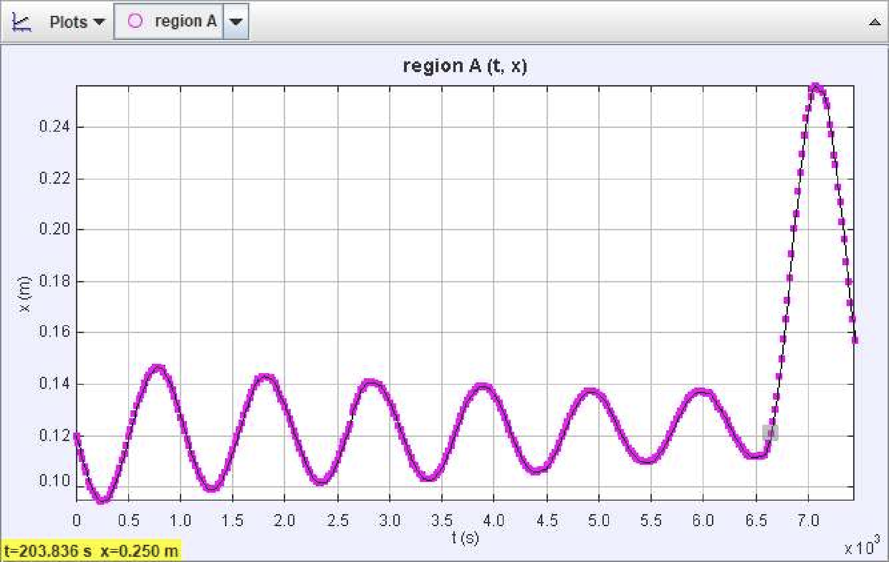
Analysis
Position time series data were extracted, allowing us to find main observables:
period T, and
angular displacement, Δθ (of equilibrium),
for both orientations of the masses.
T
Δθ

Slide 22
Results
 | G N m² / kg²
Trial 1 | 7.295 E–11
Trial 2 | 7.413 E–11
Avg. | 7.354 E–11 σ = 8.360 E–13
Accepted: 6.674 E–11 N m² / kg²

Slide 24
Sources
[1] Adam Mann. The curious case of the gravitational constant. https://www.pnas.org/doi/10.1073/pnas.16125 97113. Retrieved December 4, 2024. September 2016.
[2] American Physical Society. 1798: Cavendish Weighs the World. https://www.aps.org/apsnews/2008/06/179 8-cavendish-weighs-world. Retrieved December 4, 2024. June 2008.
[3] BlueMarbleScience. Calculating the Universal Gravitational Constant. https://www.youtube.com/watch?v=W2uPNg1BUSI. Retrieved December 4, 2024. Dec. 2020.

